Slide 1
PEGA Decisioning Essentials

Slide 2
Agenda – Session 8
Adaptive Models

Slide 3
Adaptive Models
Adaptive Models are self-learning models to predict customer behavior. i.e they can provide NBA even though any existing historical data.i.e the customer responses.
Adaptive models are used in decision strategies to increase the relevance of decisions.
ADM models are self-learning which means that they are automatically updated after new responses have been received
Adaptive Models are created at BUSINESS ISSUE Level. i.e all the offers if there are multiple propositions use the adaptive model logic if being defined.

Slide 4
Adaptive Models - Creation
n the header of the Models work area, click New Adaptive model .
In the Create adaptive model dialog box, enter the model Name and select the Business issue.
In the Positive outcome section, enter the customer responses to the behavior you want to predict:
To select an available positive outcome for the model, place the cursor in the empty field and,
press Down Arrow, and click the outcome you want to use.
To define a new positive outcome for the model, enter the outcome that you want to use.
For example:
Use Accept to indicate that a customer accepted an offer.
In the Negative outcome section, enter which customer responses represent the alternative outcome
you want to predict:
To select an available negative outcome for the model, place the cursor in the empty field,
press the Down Arrow key, and click the outcome you want to use.
To define a new negative outcome for the model, enter the outcome you want to use.

Slide 5
Adaptive Models
Adding predictors for adaptive models is same as predictions.
Go to the model
Click on PREDICTORS tab
Now u can add a single field or multiple fields to the adaptive model

Slide 6
Types of Predictions
Predictor types in PREDICTIONS are
Numeric
Categorical
But whereas In Adaptive model, there are 2 predictor types they are
Numeric
Symbolic
Create predictors which are input fields for the adaptive models. When creating an adaptive model, select a wide range of fields that can potentially act as predictors.

Slide 7
Monitoring Adaptive Models
Within the adaptive model page in prediction studio,
The Monitor tab displays the graphical view of the results that accrued as part of the model execution.
This will be displayed once the customers have responded to the offers that have strategies configured with the adaptive models.

Slide 8
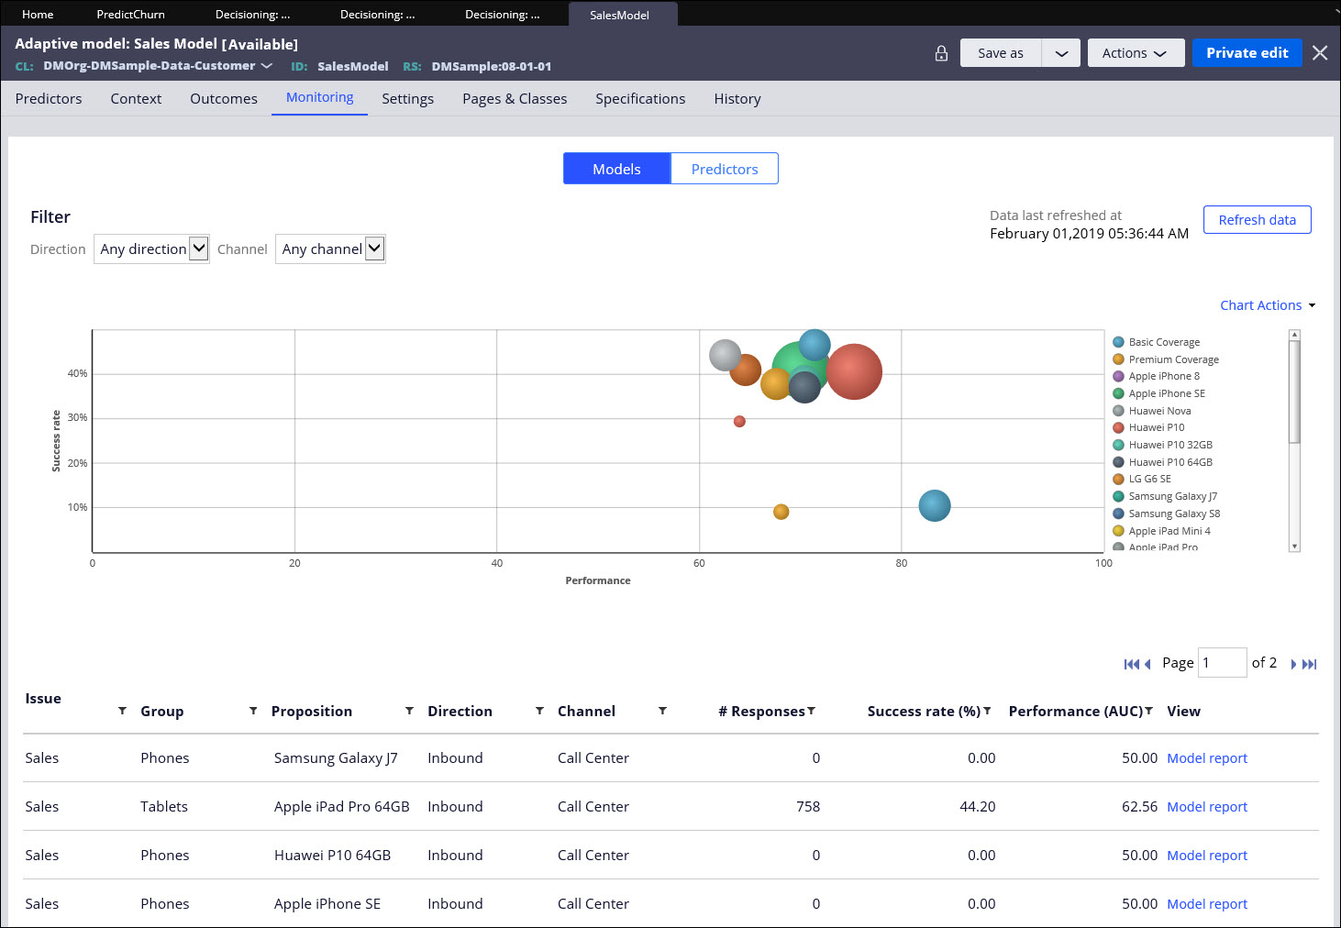
Aadptive Model

Slide 9
Adaptive Model Generation
Bubbles on the graph indicate each bubble is a proposition.
The more the number of responses occurred on a propostion, the larger the bubble size becomes.
Hover on the bubble to see the
SUCCESS RATE, PERFORMANCE (AUC ) AND NUMBER OF RESPONSES.
Success Rate ranges from 0- 100%.
Success Rate = Total Number of Positive Responses
______________________________
Total Number of Responses
For example, a proposition called “Apple Ipad Pro 32GB” is marketed to the customer and has recorded a response.
If 10 customers responded to the proposition, out of which 8 responded positive and 2 responded negative… So success rate = 8/10 * 100 = 80% success rate.

Slide 10
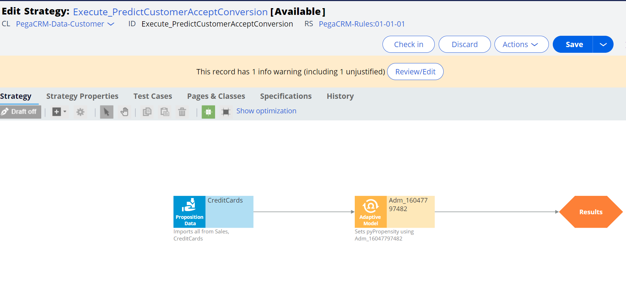
Run the strategy and notice that the adaptive model yields propensity to the results as below. For the first time run, the propensity is set to 0.5 since ADM Service has no previous interaction history about the customer.

Slide 11
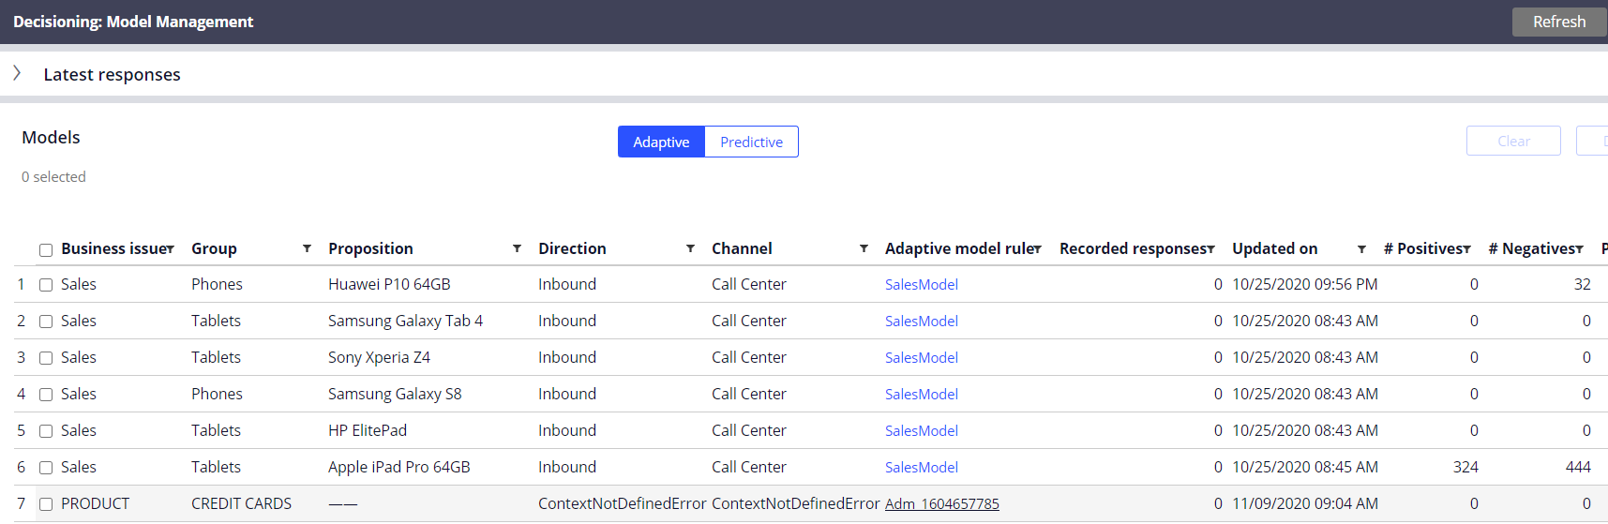
Updating Prediction
Adaptive Models can be visible from the Configure > Decisioning > Model Management.
Look for the model that u created and u r able to see the model in the list of adaptive models

Slide 12
Grouping Granularity
The 'grouping granularity' controls the threshold for what to consider statistically significant. Using a more granular settings could result in more groups, e.g 0-12, 12-16, 16-24, 24-38, 38-65 and 65-80. I.e. 6 groups instead of 3. More groups might give better predictions, but it also increases the risk of 'overfitting' - if the groups become too granular, they are becoming less predictive.
For example, assume there is a group for only 23-year olds, and only a single 23 year old customer was observed who accepted the offer.
The model would then assume that *all* 23 year olds would accept the offer. I.e. the model no longer generalizes. The default settings usually give the best balance between predictive power and 'robustness' (resilience against over-fitting).
The 'minimum number of cases' control the minimum number of cases (fraction) that should end up in each group. I.e. a value of 0.05 indicates that each group should contain at least 5% of all cases - this implies that there will be at most 20 groups.
A value between 0 and 1 that determines the granularity of predictor groups; higher values result in more groups, lower values in less groups. This setting establishes the threshold for a statistical measure that indicates the distinctive behavior between predictors groups. If the measure is above, the groups indicate significant distinctive behavior, otherwise they will be collapsed. The default setting is 0.25.

Slide 13
Binning
Binning options for numeric predictors
Binning of numeric predictors allows you to group cases into bins of equal volume or width.
CASES – CUSTOMERS FALLING IN EACH BIN
BINS – PARTITIONS MADE IN EQUAL INTERVALS.
For example:
For example, your cases are customers that you want to group according to their age in bins of equal width. You can create bins for customers aged 20-29, 30-39, 40-49, and so on. Each bin contains a number of customers from the specific age group. When you decide to group the customers into bins of equal volume, you can create a certain number of bins and Prediction Studio divides the cases equally among the bins.
It is possible do binning both on numeric fields as well as symbolic fields
That is the reason u see the column name as Range/Symbols.
Symbolic binning has values Optional: Enter a value between 0 and 200 for the most frequent remaining values.

Slide 14
Questions!

